Slide 1
MS-MTA
DES Model R Project guide
File structure & contents

Slide 2
File Structure
Raw-data
Data
R
Analysis
Figs
Report
Vignettes
tests
CSV / Excel files
Cleaned /
processed
Functions:
data input
model
deterministic
probabilistic
VOI
Calibration
Validation
Inactive folders for now
Replicates the functions saved in R
&
“master.R” script runs the functions
Output

Slide 3
Raw-data
Natural History
natural_history.R
Mortality
all_cause_mortality.R
Baseline
baseline_severity.R
Treatment Effects
init_params.R
adverse_events_probabilities.R
Utilities
utilities.R
Costs
costs.R

Slide 4
Data
Natural History
df_nh_rrms_bc_ta616.rds
Mortality
df_all_cause_mortality.rds
Baseline
df_baseline_severity.rds
Treatment Effects
df_init_params.rds
df_relapse.rds
df_adverse_events_probabilities_ta616.rds
df_duration_relapse.rds
df_trt_discont_ta616.rds
Utilities
df_u_adverse_events_ta616.rds
df_u_relapse.rds
df_u_edss_ta616
df_u_carer_ta616
Costs
df_c_monitoring_.rds
df_c_relapse_ta616.rds
df_c_relapse.rds
df_c_direct_edss_ta616.rds
df_c_drugs_ta616.rds
df_c_disutilities_ta616.rds

Slide 5
R

Slide 6
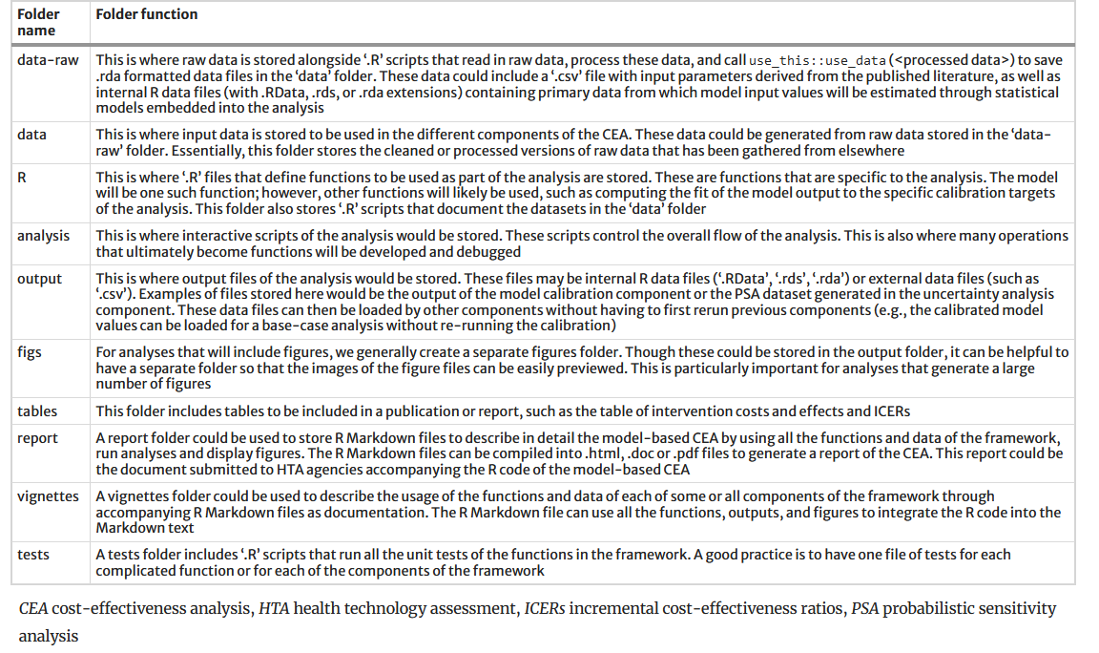
File folder structure for organizing model and analysis files used in the proposed DARTH coding framework

Slide 7
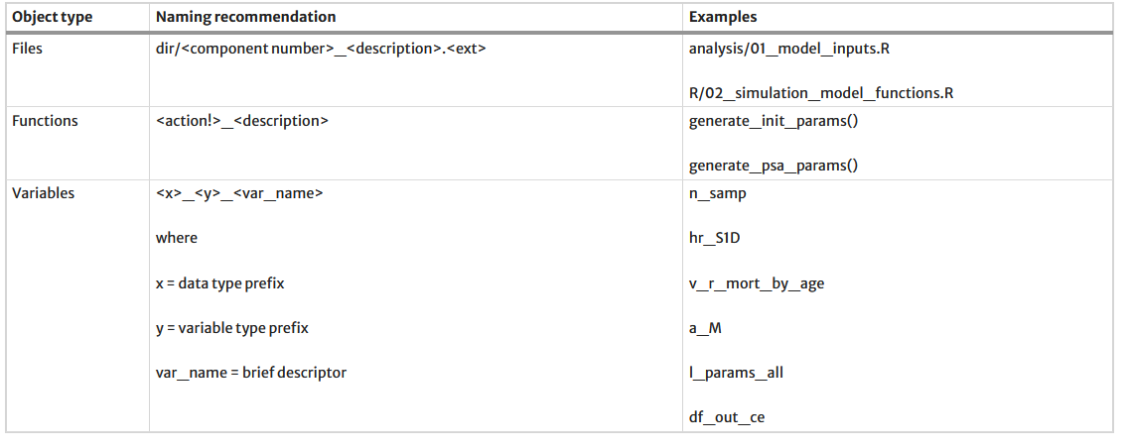
File and variable naming conventions in the proposed DARTH coding framework

Slide 8
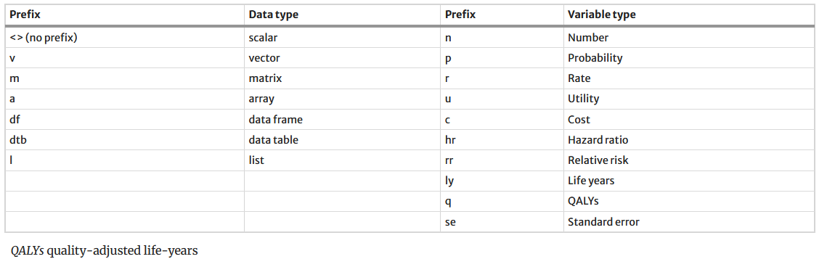
Recommended prefixes in variable names that encode data and variable type

Slide 9
Refrences
Alarid-Escudero, F., Krijkamp, E.M., Pechlivanoglou, P. et al. A Need for Change! A Coding Framework for Improving Transparency in Decision Modeling. PharmacoEconomics 37, 1329–1339 (2019). https://doi.org/10.1007/s40273-019-00837-x

